Slide 1


Pushing Performance Isolation Boundaries into Application with pBox
Yigong Hu, Gongqi Huang, Ryan Huang
SOSP’23
Notes:
Hi everyone, I am Yigong Hu from Johns Hopkins University. Today, I will present our work Pushing Performance Isolation Boundaries into Application with pBox. This is a joint work with my co-authors Gongqi and Ryan.

Slide 2



Performance Isolation Is Critical in Application
SLOW
Inter-application performance interference
Shared Resource
*Caladan(OSDI’20),PARTIES(ASPLOS’19)
Notes:
Providing performance isolation is crucial in multi-application environments to ensure that each application can maintain a consistent and predictable performance. Inter-application performance inference, which comes from contention for shared system resource, has the potential to introduce unpredictable performance regressions. To address this issue, decades of work have focused on ensuring that applications running on the same system can coexist without significantly degrading each other's performance.

Slide 3


Intra-application Performance Interference
Performance interference can happen inside application
  Tasks in same application contend for shared application virtual resources
  Cause severe performance interference in production
Request 1
Request 2
SLOW
Application
buffer
queue
Index
Notes:
However, modern applications are becoming increasingly concurrent, running a diverse mix of activities simultaneously. This concurrency introduces a new challenge: performance interference within applications, which we refer to as 'intra-application performance interference.’ When a noisy task monopolizes a shared application virtual resource such as a global queue, it disrupts the performance of other tasks, causing an intra-application performance interference.
Unlike traditional inter-application interference, intra-application interference is caused by the contention on the resource designed and implemented by application developers.

Slide 4

Intra-app Interference Example
Long read Transaction
Continuous
write queries
Purge thread
…
MySQL
UNDO log
Purge thread triggered
4X throughput decreases
Long read transaction join
Notes:
Here is an example of intra-application interference caused by UNDO log contention. In this experiment, we begin by running a client that continuously sends write requests to the server. After 30 seconds, we introduce a new client executing long read transactions on the same table. To maintain multiple versions of the table, MySQL accumulates an increasing UNDO log. When a read transaction completes, it triggers the purge thread to clean up the older UNDO log entries. This cleanup process, while not due to any inherent design flaw in the UNDO log itself, creates resource contention within the UNDO log. This contention, in turn, leads to performance interference on the write query.

Slide 5
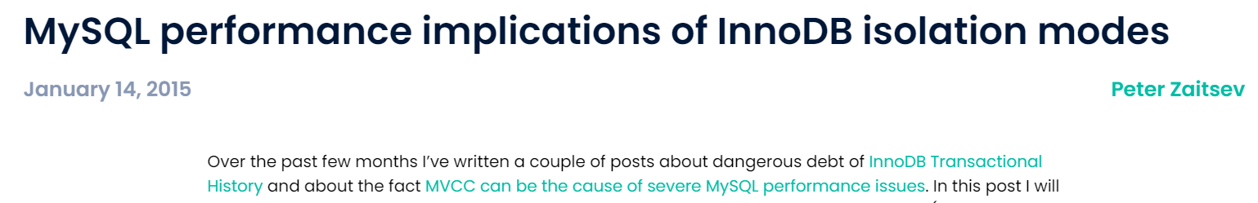
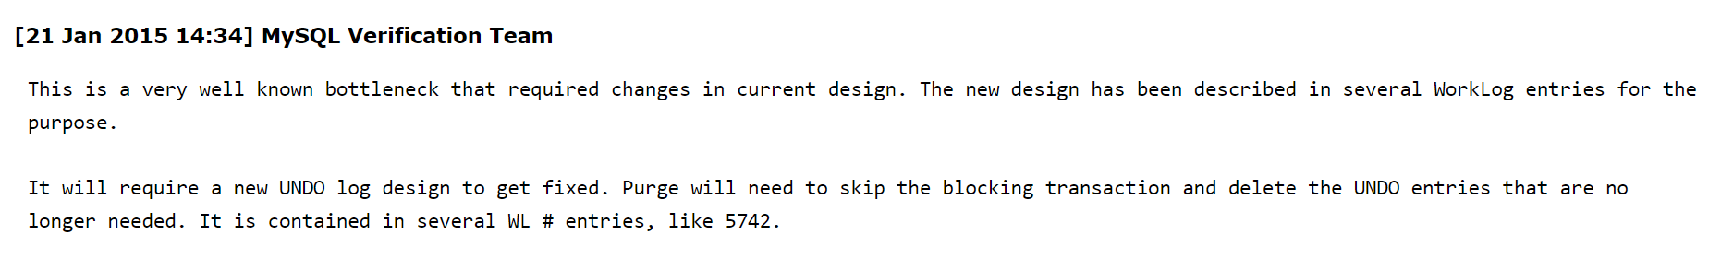
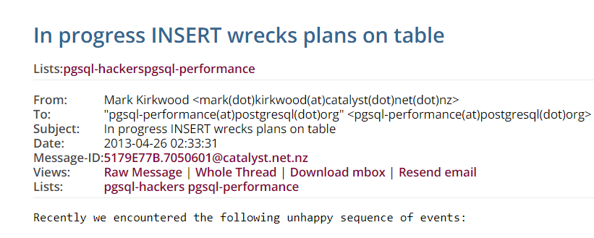
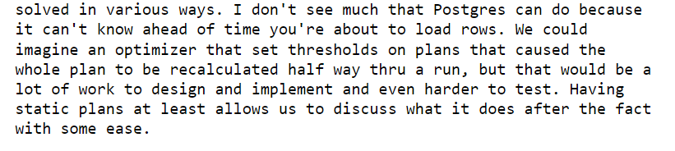
Intra-app Interference Is Prevalent
Notes:
Because of this subtle effect, addressing intra-application performance interference often requires a comprehensive redesign of the contended resource. This can be a time-consuming process for developer, leading to prolonged periods where intra-application interference remains within an application, potentially impacting performance for an very long time.

Slide 6
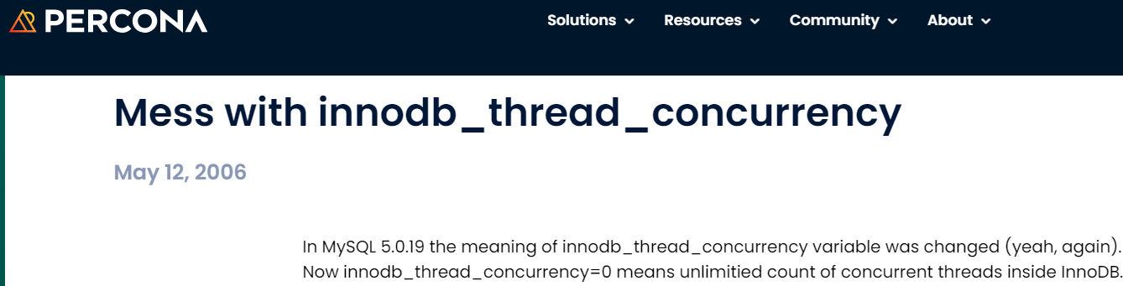
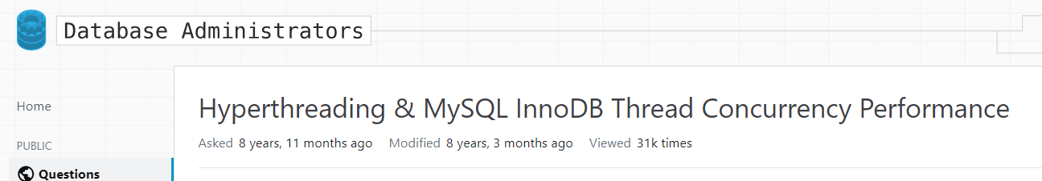
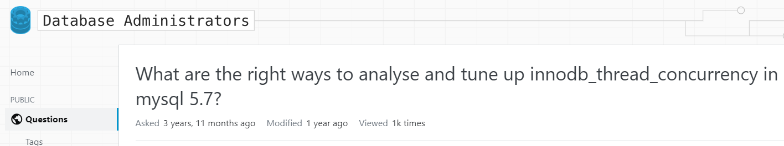
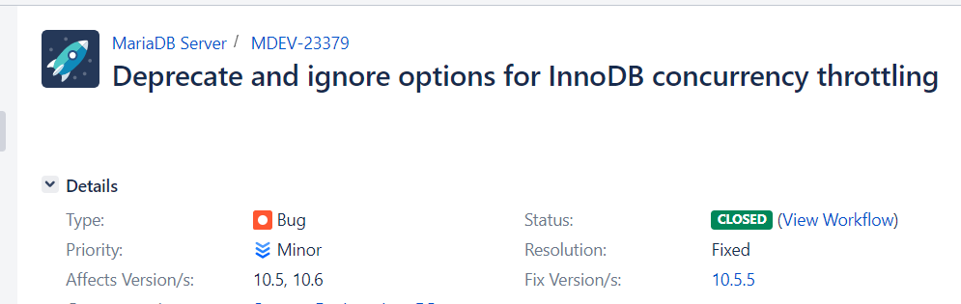
Intra-app Interference Is Long-lived
2006
2014
2017
2020
Notes:
For example, the parameter 'innodb_thread_concurrency' in MySQL and MariaDB has been reported by numerous users over the past 15 years. Until it was eventually deprecated by MariaDB. Given that intra-application interference can exist within an application for an very long time, there is a need for system mechanisms to mitigate intra-application performance interference at runtime.

Slide 7
Current Practice of Performance Isolation
Practice 1: performance isolation by partitioning hardware resource
Application
Application
Problems:
Application virtual resource is invisible to OS
Allocating hardware resource can’t directly affect application resource contention
Interference
CPU
CPU
Memory
Memory
Disk
Disk
Notes:
Currently, most performance isolation mechanisms are partitioning system resources and dynamically adjusting these partitions. However, these mechanisms is inefficient in dealing with intra-application performance interference because the application's virtual resources remain hidden from the system's view. Consequently, traditional partitioning methods cannot detect contention within these virtual resources.

Slide 8
Current Practice of Performance Isolation
Practice 2: fine-grained resource quota
Application
Solutions:
Assign Fixed resource quota
Trace application tasks’ resource usage
Deny excessive resource usage
Problems:
Resource usage is shifting
Hard to set quota statically
CPU
CPU
Memory
Memory
Disk
Disk
CPU
CPU
Memory
Memory
Disk
Disk
Notes:
An alternative approach is to allocate fine-grained resource quotas to individual application tasks. In this method, the system actively monitors the resource usage of these tasks and blocks any usage that exceeds predefined thresholds. However, the application virtual resource usage pattern is constantly shifting. This constant fluctuation makes static resource quotas hard to effectively maintain good performance."

Slide 9
Issues of Current Practice
Difficult to enforce isolation inside applications
“Invisible to diverse application-level virtual resources
Insufficient and inflexible to enforce resource quota
Notes:
In summary, existing inter-application performance isolation mechanisms have three limitations. First of all, the current method is difficult to enforce isolation within applications. Second, many application level virtual resources are invisible to these mechanisms,making it difficult to mitigate interference solely by adjusting hardware resource. Finally, it is insufficient and inflexible to enforce fixed resource quota in addressing intra-application interference.

Slide 10
Our Solution – pBox
Difficult to enforce isolation inside applications
Let developers define performance isolation domain in application
“Invisible to diverse application-level virtual resources
Expose set of APIs to easily trace application resource usage
Insufficient and inflexible to enforce resource quota
Design mechanism to detect and mitigate intra-app interference
Notes:
To address these issues, we propose and implemented a new OS abstraction called pBox that shifts the performance boundaries directly into the application itself. With the pBox abstraction, developers gain the flexibility to define arbitrary performance isolation boundaries within their applications. The pBox provides a set of APIs for monitoring application resource usage and has a new mechanism to detect and mitigate intra-application performance interference without breaking application logic.

Slide 11

Key Behavior of Intra-app Interference
Insight: make the OS aware of virtual resource contention
Task A
Task B
hold
Block
Resource A
Application
Kernel
CPU
Memory
Disk
Resource Management
Notes:
Most of the intra-application performance interference are caused by contention among the application resource, which are invisible to traditional system resource management. This inherent invisibility makes system resource management difficult to detect and mitigate the interference by simply adjusting hardware resource. Our key insight with pBox is that by making the operating system aware of virtual resource contention within applications, we empower the system to actively monitor and control the usage of application virtual resources, thus make effective mitigation of interference possible.

Slide 12
Performance Box
Design goal: monitor application resource contention and expose to Kernel
Task A
Task B
pBox
Block
pBox
hold
Resource A
pBox Runtime
Application
Kernel
pBox Manager
CPU
Memory
Disk
Resource A
Resource Management
Notes:
Built on this insight, pBox divides an application's execution into independent activities. It traces crucial application resource usage through its library and communicates this information to a kernel-level manager. This manager monitors all pBox resource usage and uses a detection algorithm to identify any potential intra-application interference within pBoxes. When the manager detects such potential interference, it then carefully takes actions to mitigate the interference.

Slide 13
pBox APIs
Easily define the isolation boundary by developers
Automatically enforce performance isolation among pBox
Create | int create_pbox(IsolationRule rule); int release_pbox(IsolationRule rule);
Activate | int activate_pbox(int psid) ; int freeze_pbox(int psid);
Trace | int update_pbox(size key, event_type event);
Notes:
We provide pBox as a set of APIs. With pBox, developers can easily create a pBox, define the isolation boundaries for their application, activate it and trace the application resource usage. These APIs empower developers to directly build new isolation boundaries within their applications, and pBox can enforces the required performance isolation automatically."

Slide 14
pBox Creation
void add_connection(THD *thd) {
…
While (thd_connection_alive(thd)) {
if (do_command(thd))
break;
end_connection(thd);
}
  close_connection(thd);
}
Loop to handle all requests from one client
Example: MySQL thread handler for a client connection
Notes:
Here is an example of using pBox to define an isolation boundary for MySQL user connections. When MySQL receives a user connection, it invokes add_connection function. Within this function, there exists a loop that efficiently manages and handles the requests sent by the client.".

Slide 15
pBox Creation
void add_connection(THD *thd) {
rule = { .type = RELATIVE, .isolation_level = 50 };
psid = create_pbox(rule);
…
While (thd_connection_alive(thd)) {
if (do_command(thd))
break;
end_connection(thd);
}
  close_connection(thd);
  release_pbox(psid);
}
Isolation
rule
Loop to handle all requests from one client
Handle one request
Example: MySQL thread handler for a client connection
Notes:
Developers can insert the create_pbox before the loop to create a pBox and release the pBox when the connection is closed. This API includes a parameter known as 'isolation rule,' enabling developers to specify the desired level of isolation to be enforced on the given pBox.

Slide 16
Define pBox Isolation Area
bool do_command(THD *thd) {
…
command = thd->net.read_pos[0];
ret = dispatch_command(command, thd, ...);
…
}
Example: MySQL thread handler for a client connection
Notes:
When a connection is in the process of handling a request, the system calls the 'dispatch_command' function to carry out the actual tasks required by the request.

Slide 17
Define pBox Isolation Area
bool do_command(THD *thd) {
…
command = thd->net.read_pos[0];
psid = get_current_pbox();
…
activate_pbox(psid);
ret = dispatch_command(command, thd, ...);
freeze_pbox(psid);
…
}
Additional code to filter out requests from pBox’s isolation area
Example: MySQL thread handler for a client connection
Notes:
Developers can activate the corresponding pBox as needed. This activation can occur before the 'dispatch_command' function is invoked. Additionally, developers can write custom code to selectively filter out requests on which they do not wish to enforce performance isolation."

Slide 18
pBox APIs for Thread Pool Model
API: int bind_pbox(size_t key, unbind_flags flags)
int unbind_pbox(size_t key, unbind_flags flags)
Functions to transfer the ownership of pBox:
bind_pbox finds the pBox from the key and binds it with the current thread
unbind_pbox detaches the pBox from current thread
Detach/attach to thread when the task is detached/attached from thread pool
Notes:
To support the event driven model where many application tasks shares a common thread pool. pBox also provides two APIs for dynamically binding and unbinding of the pBox to/from the current thread.

Slide 19
How to Trace Application Resource
Require developer to expose resource usage
  High overhead to inform every changes of resource
Observation:
  two key questions for performance interference: which activity is causing delay and which one is deferred
  But we also need to adapt different resource implementation, variable types and resource use pattern
Our approach:
  A new concept, state event, to capture key application resources event
Notes:
With the pBox abstraction, the next challenge is tracing the application resource usage, the most straightforward way is to notify the system with every changes in application resources but this approach can introduce significant overhead. Moreover, application resource design tends to be highly specific. We observe that regardless of the diverse implementations of application resources, addressing performance interference typically revolves two questions: identifying the source of delays and identifying the tasks that are deferred. Based on this observation, we introduce a new concept called state event that enables efficient tracing of both noisy and victim tasks within application resources.

Slide 20
State Event
PREPARE | A pBox is derferred by an application resource
ENTER | A pBox is no longer derferred by an application resource
HOLD | A pBox is holding an application resource
UNHOLD | A pBox releases an application resource
API: int update_pbox(size_t key, event_type event)
Notes:
The state event has four states, PREAPRE,ENTER,HOLD and UNHOLD. PREPARE and ENTER events are designed to capture how long a pBox is blocked by an application resource. The HOLD and UNHOLD events are triggered when the resource is hold or released by the pBox. These events are communicated to the pBox manager through the update_pbox function call.

Slide 21
Tracing Deferring Time by State Event
Holding time
noisy pBox
victim pBox
Defer time
Shared
Resource
PREPARE
ENTER
HOLD
UNHOLD
Notes:
Here is an example of using state event to trace deferring time and pinpoint the cause of deferral. When the noisy pBox holds a shared resource, a HOLD event is transmitted to the pBox manager. The pBox manager, in response, marks the 'purple' pBox as the holder of this resource. Subsequently, When the orange pBox is blocked by the resource, a PREPARE event is generated. At this point, the pBox manager begins the calculation of deferring time, which continues until the 'purple' pBox issues an UNHOLD event, followed by the 'orange' pBox transmitting an ENTER event. The pBox traces all these events acorss an activity, enabling the detection of intra-application performance interference.".

Slide 22
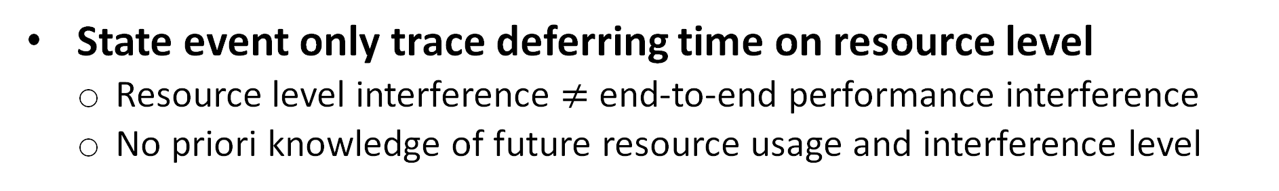
Detecting Performance Interference for Activity
State event only trace deferring time on resource level
  Resource level interference $≠$ end-to-end performance interference
  No priori knowledge of future resource usage and interference level
Notes:
While state events allow us to determine if a task is deferred by a resource, this information alone is insufficient for detecting intra-application performance interference. Resource-level deferral is a low-level detail that is not equivalent to end-to-end application performance. To effectively detect intra-application performance interference, we require a method to bridge the gap between these resource-level usage details and the overall end-to-end performance of the application."

Slide 23




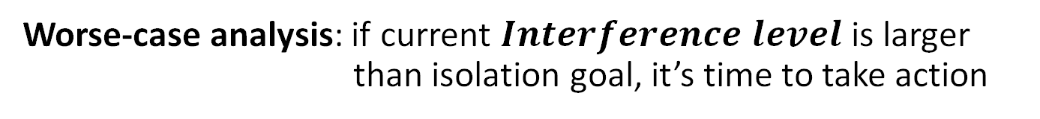
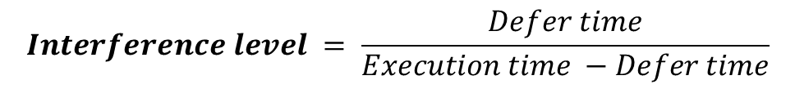
Activities' Interference Level
Resource A
Resource B
pBox
$$Defer time=$$
${enter}_{A}$ - ${prep}_{A}$
$$+$$
${enter}_{B}$ - ${prep}_{B}$
$$Interference level = \frac{Defer time}{Execution time −Defer time}$$
Worse-case analysis: if current $Interference level$ is larger than isolation goal, it’s time to take action
PREPARE
ENTER
HOLD
UNHOLD
Notes:
To bridge this gap, we introduce a new metric known as 'interference level.' We begin by aggregating all the defer times associated with each resource to calculate the total defer time for a task. Subsequently, we compute the interference level by dividing the interference time by the ideal execution time, assuming zero deferring time. pBox uses a worst-case analysis approach to detect the interference.

Slide 24
Competitor Map + Holder Map
pBox A
pBox B
pBox C
Resource A
Resource A
Resource A
Resource A
pBox B
pBox C
Resource A
pBox A
Competitor map
Resource B
Holder map
Resource B
Resource C
Resource C
$$Interference level>isolation goal ?$$
PREPARE
ENTER
HOLD
UNHOLD
…
…
Notes:
Let's delve into the process of detecting intra-application performance interference. Within pBox, we maintain two maps: the competitor map, and the holder map. Each of these maps maintains a list of resources.
When a pBox sends a HOLD event, it gets appended to the associated resource's list in the holder map. If a pBox sends a PREPARE event, it is placed into the competitor map. Now, when a pBox in the holder map release the resource, the pBox manager steps in and checks whether any pBoxes in the associated competitor map exceed their isolation rule. If this threshold is exceeded, the manager marks the pBox in the holder map as the 'noisy' pBox and the pBox in the competitor map as victim' pBoxes

Slide 25
Interference Mitigation
Reallocating application resource can introduce dangerous side effects to application
Mitigating interference without breaking application logic
  Adding a delay to noisy activity
  Only penalize the noisy pBox when a UNHOLD event is received
Handle nest state events
  A noisy pBox can hold multiple resources
  Only penalize when pBox no longer holds any application resource
Notes:
Once the pBox manager detects an interference, it start to mitigate the interference. In the mitigation process, it is crucial to ensure that any actions taken do not disrupt the application logic or introduce dangerous side effects. Thus, pBox uses a straightforward yet safe action: it introduces a delay to the 'noisy' activity. Before applying this delay, pBox waits until all resources held by the pBox are released to prevent exacerbating the interference.

Slide 26
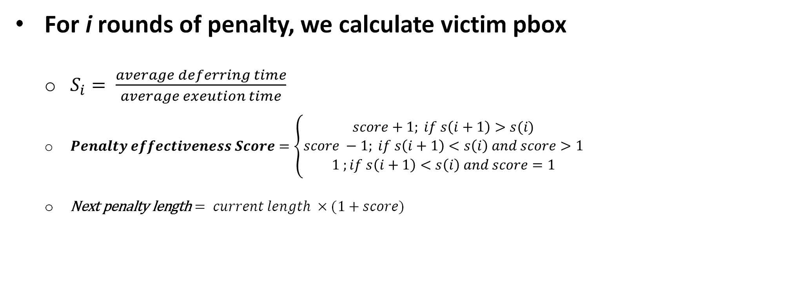
Score-based Penalty Length Adjustment
For i rounds of penalty, we calculate victim pbox
  $S_{i}= \frac{average deferring time}{average exeution time}$
  $Penalty effectiveness Score=\left\{\begin{aligned}score+1; if s\left(i+1\right)>s(i) \\ score −1; if s\left(i+1\right)<s\left(i\right) and score>1 \\ 1 ;if s\left(i+1\right)<s\left(i\right) and score=1\end{aligned}\right.$
  $\text{Next} \text{penalty} \text{length}= current length ×(1+score)$
Check paper for details
Notes:
The duration of the penalty in pBox is critical, as it affects its effectiveness. We design two adaptive penalty length policies. The score-based approach assesses the penalty's impact by comparing if the previous penalty improve performance and adjust the length of the next penalty. We also have another policy detailed in the paper

Slide 27
Other Optimization
Lightweight Tracing
  Pre-allocation for frequently used data struct to reduce the need for additional memory calls
  Reduce the number of syscalls like update_pbox
  Optimizing the datastruct
Lazy unbind
  unbind_pbox only marks a pbox as detached from thread
  only detach when bind_pbox bind the pbox to a different thread
Notes:
As pBox operates as a runtime abstraction, its performance is a critical consideration. To minimize overhead, we make several optimizations such as optimizing data structures, preallocating important data structures, reduced the number of system calls and implementing lazy unbind for bind API.

Slide 28
Evaluation
Can pBox reduce intra-application interference?
How does pBox compare to state-of-art solutions?
What is the overhead?
Notes:
In our evaluation, we want to answer the three questions:

Slide 29
Experiment Setup
Implemented in Linux kernel 5.4.1 with a user-level library
A Static analyzer to find the state event
Ported to five systems
  MySQL, PostgreSQL, Apache, Varnish, Memcached
Software | SLOC | SLOC Added | Inspected Functions
MySQL | 1.74M | 192 | 83
PostgreSQL | 629K | 127 | 71
Apache | 198K | 71 | 43
Varnish | 59K | 77 | 53
Memcached | 19K | 70 | 22
Notes:
The pBox is implemented in Linux kernel with a user level library. We also implement a static analyzer to help inserting the state event. The pBox is evaluated on five populate systems. Each one has hundreds of thousands line of code and as you can see, we only add less than 200 lines of code for each system, which is a very small amount of manual effort. The last columns shows the number of function we inspect for each application if we insert the code manually. The number can be greatly reduced by our static analyzer

Slide 30
Microbenchmark
Test latency of pbox APIs compared with get_pid
update1* update_pbox under no interference
update2* update_pbox under interference
Notes:
We start with microbenchmark. We test all six pBox APIs and compare the pBox create latency with the pthread_create. We show that the pBox creation is 3 times faster than the thread creatation and the latency for the rest APIs is close to getpid syscall, which is very lightweight

Slide 31
Real-world intra-app interference cases
ID | Application | Contending Resource | Description
C1 | MySQL | table | Write query blocked by long update query
C2 | MySQL | global mutex | Inserting query on table without primary key has contention
C3 | MySQL | tickets | Query blocked on innodb thread concurrency
C4 | MySQL | transaction history length | SERIALIZABLE isolation causes overhead to read query
C5 | MySQL | UNDO log | Background purge task blocks client request
C6 | PostgreSQL | index search tree | In-progress INSERT delayes other queries
C7 | PostgreSQL | database table | Long update query blocks other requests
C8 | PostgreSQL | database table | buffer content lock contention on SHARED lock
C9 | PostgreSQL | dead table rows | Vacuum full process blocks other requests
C10 | PostgreSQL | write-ahead log | A large WAL blocks requests
C11 | Apache | fcgid request queue | slow request in mod_fcgid blocks other fast connections
C12 | Apache | apache thread pools | Apache locks server if reaching maxclient
C13 | Apache | php thread pool | Apache server slows due to contention on php connection
C14 | Varnish | varnish thread pool | Slow request on visiting big objects block other request
C15 | Varnish | system lock | lock contention with high number of thread pools
C16 | Memcached | system lock | lock contention in the cache replacement
Notes:
We then test pBox on real-world applications. We collect 16 real-world intra-application performance interference cases. The contending resource for each case comes from various categories such as thread pool, table, UNDO log, and index search tree.

Slide 32
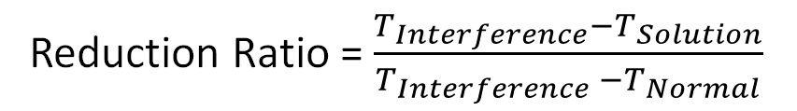
Performance Interference Reduction
Reduction Ratio = $\frac{T_{Interference}−T_{Solution}}{T_{Interference} −T_{Normal}}$
pBox: 86%
Notes:
We define a metric called reduction ratio to quantify the number of reductions for intra-application interference. The closer the ratio is to 100%, the more performance interference it mitigates. If the ratio is negative, it means the policy make the performance worse. As we can see, the pBox can mitigate the performance interference for 15 cases with an average reduction ratio of 86%

Slide 33
Performance Interference Reduction
Number of case improved:
pBox (15/16) ; cgroup(3/16); PARTIES(3/16); Retro(5/16); DARC(3/16)
Notes:
We also conduct a comparative analysis of pBox with state-of-the-art solutions. These works are designed to achieve performance isolation across applications. The result shows that inter-application isolation mechanisms often result in performance degradation in most intra-application performance interference cases, while pBox can improve the performance for most cases. Also pBox’s average reduction ratio is also higher than other approaches.
.

Slide 34
pBox Overhead
Read-intensive workload:
Write-intensive workload:
Notes:
In our overhead experiment, we conducted both read-intensive and write-intensive workloads on five different systems, varying the number of clients. The results demonstrate that pBox introduces a negligible overhead, with an impact of less than 6% in all cases.

Slide 35
Conclusion
Intra-application performance interference is difficult to mitigate
Performance isolation needs to be enforced inside application
pBox, an abstraction to push performance isolation into application
  Make OS aware of application resource usage
pBox mitigate 15/16 interference cases with a 86% reduction ratio
Thank you!
Notes:
So in conclusion, we found that performance interference can also happen inside applications and it is difficult to mitigate. To mitigate the intra-application performance interference, we propose pBox, an abstraction that pushes performance isolation boundaries into applications by making the OS aware of application resource usage. Our experiments demonstrate pBox's, successfully mitigating fifteen out of sixteen test cases with an average reduction ratio of 86%.

Slide 36
Question List: Motivation
Why design pBox in kernel? Or Why pBox should be a OS abstraction
How does pBox deal with micro-second level activity
Notes:
Answer 1: It is a trade-off between performance, transparency, and flexibility. pBox is essentially an effort to improve the scheduling of application activities for performance isolation, which is an important property that the OS should provide to applications. Also, implementing pBox in the kernel makes controlling the timing of pbox action and tracing system resources easier
Answer 2: pBox’s action time might not be negligible for microsecond activity. For microsecond-level applications, if the interference is not significant, the pBox might not improve performance. However, pBox is still useful for severe performance interference for microsecond application

Slide 37
Question List: Design
How many manually effort to insert state event
How does developer know the correctness of instrumentation
Does pBox need a dedicate core? If so, what is the overhead
Would pBox make wrong penalty decision
Would pBox take penalty too late
How does pBox support event driven
Notes:
Answer 1 The highest number of hooks is 192 SLOC in MySQL. We think this relative effort is quite acceptable. Also, much of the instrumentation efforts can be automated with our static analyzer. In our paper, we also provide a heuristic to guide developers to find state events.
Answer 2: Developers can write specific benchmarks that reproduce past interference issues to test the correctness of instrumentation. This effort is similar to writing a non-trivial performance test. Also, our static analyzer can run a sanity check. Also, even if developers initially miss certain instrumentation, they can easily add it later during or after a production performance issue
.Answer 3: No, pBox runs as a runtime library.
Answer 4: Yes, for some specific cases, pBox might make an incorrect decision. For example, if the noisy pBox holds the resource for a long time but not long enough to trigger the pBox’s detection, pBox might miss this noisy pBox. However, such situations should be uncommon as it requires subtle triggering condition. To handle this potentially rare case, one possible extension for our detection algorithm is to add another past holder map that stores past holder information.
Answer 5: Yes, if the interference is caused by a noisy pBox holding a virtual resource for a long time near the end of an activity’s execution, by the time the pBox manager can safely act, the penalty may be useless. However, we need to make a trade-off between the safety and the performance. If we add a more complex transaction-based design, the action would incur too much overhead and cause application disruption. In our pBox design, we make the detection algorithm proactively detect the interference to find the interference as early as possible. Also, in real-world intra-application interference cases, a noisy pBox often creates contention on some virtual resource more than once
Answer 6: The bind and unbind pBox APIs take a flag that can indicate whether the currently bound thread is a shared thread or a dedicated thread. If a noisy pBox is bound with a dedicated thread, the manager takes action immediately. If the bound thread is shared, penalizing the noisy pBox with a delay would prevent other pBoxes from using this thread. The manager instead makes the following activities from the noisy pBox wait in the task queue for a while.

Slide 38
Question List: Evaluation
It is unclear how pBox behaves for intra-application interference
What will happen if pBox policy make wrong decision
Is there any parameter in pBox
Why you only test on 15 cases
Notes:
Answer 1: we measure the number of penalty actions in 8 cases. In general, pBox takes more penalty actions under a high interference level. However, if the interference level is too high, fewer penalty actions may occur
Answer 2: pBox design is robust to mis instrumentation. We evaluate whether pBox can tolerate mistakes in using pBox APIs by randomly removing 10% of the update_pbox calls. On average, 4 out of 5 cases show positive mitigation, with an average interference reduction ratio that is slightly lower than correct usage
Answer 3: One parameter is important when using pBox, the isolation rule, which specifies the maximum performance slowdown compared to the ideal noninterference execution. For example, a rule of 50% indicates that the pBox’s execution latency should not be more than 50% worse than the latency if there was no interference. In general, a more relaxed isolation level can decrease the mitigation effectiveness.
Answer 4: pBox is a performance interference mitigation framework rather than a general scheduler. Thus, Running normal workload in pBox would not trigger any actions.

Slide 39
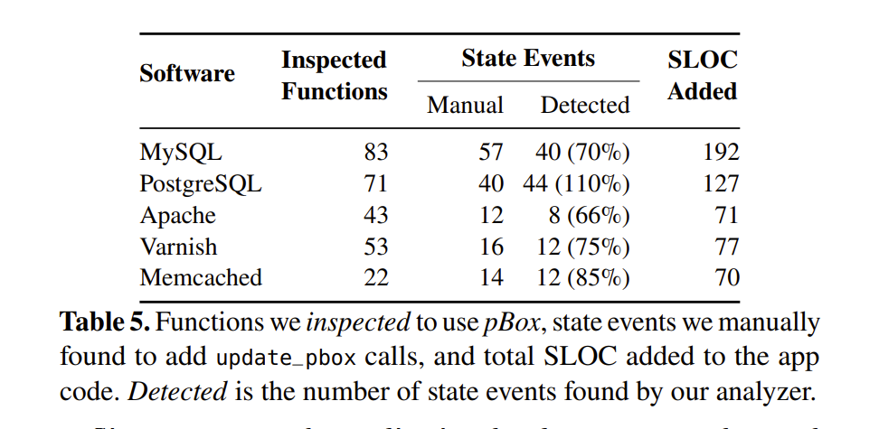
Static analyzer

Slide 40
Effectiveness of Different Penalty Length
Notes:
We then test the effectiveness of pBox when choosing different penalty length. We use a fixed penalty length of 10 ms, 100 ms and the adaptive policy. The adaptive penalty performs better for 7 out of 9 cases

Slide 41
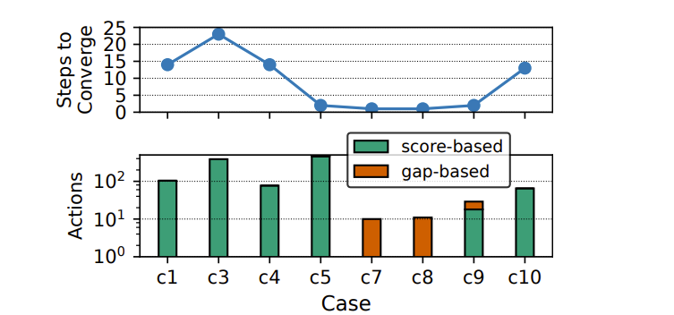
Penalty
Notes:
The tasks inside application can also has performance interference with each other and cause server performance degradation. Th
When application tasks is contenting on an application resource and some task hold the resource for a very long time, the user would observe a serve performance degradation on the application overall performance. As you can see, for example, a contention on a thread queue in MySQL causes a 6 times performance degradation to the MySQL’s throughput. For simplicity, we call this intra-application performance interference.
s
performance interference can also happen inside application.
in addition to the system resources, application also implements different resources that are shared by tasks inside the application. This resource can be a software buffer pool, a queue or a global index. The As modern application are high concurrent, many application tasks can run simultaneously on these shared resources. Since the application resource is used on the software path, they do affect the performance

Slide 42
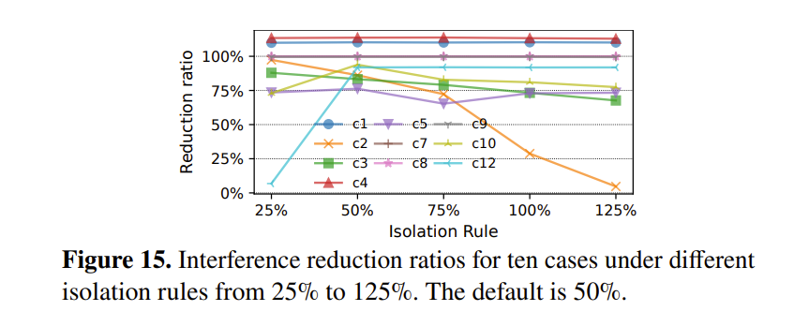
Rule
Notes:
The tasks inside application can also has performance interference with each other and cause server performance degradation. Th
When application tasks is contenting on an application resource and some task hold the resource for a very long time, the user would observe a serve performance degradation on the application overall performance. As you can see, for example, a contention on a thread queue in MySQL causes a 6 times performance degradation to the MySQL’s throughput. For simplicity, we call this intra-application performance interference.
s
performance interference can also happen inside application.
in addition to the system resources, application also implements different resources that are shared by tasks inside the application. This resource can be a software buffer pool, a queue or a global index. The As modern application are high concurrent, many application tasks can run simultaneously on these shared resources. Since the application resource is used on the software path, they do affect the performance

Slide 43
How to Find State Event
Manually instrumenting all state events in code base
  To much domain knowledge
  A lot of resource -> waste time
  Instrumentation can be error-prone
Notes:
When the state event, the next question is how to insert all state events in an application. The instrumentation require a lot of domain knowledges and would might take long time for developer to find all the state event. The instrumentation itself can also be error-prone

Slide 44
Notify State Event to pBox Manager
void srv_enter_innodb() {
…
for(;;) {
if(srv_conc.n_active < thread_concurrency) {
n_active = os_atomic_inc(&srv_conc.n_active);
if(n_active <= thread_concurrency) {
srv_enter_innodb_with_tickets(trx);
return;
}
}
os_thread_sleep(sleep_in_us);
}
…
}
void srv_exit_innodb() {
…
os_atomic_dec(&srv_conc.n_active, 1);
…
}
get the thread tickets, enter innodb
no thread tickets, block itself
Notes:
Here is an example of instrumentation of state event. MySQL’s innodb has a concurrency control mechanism, only the n_active number of thread can enter the innodb at the same time. If the concurrency limit is reached, the thread would blocked itself and try to enter the innodb later. We find that the variable n_active is the variable that control the innodb thread concurrency. If the thread enter the innodb, it will increment the n_active by one and when the thread exit the innodb, it will decrease the n_active.

Slide 45
Notify State Event to pBox Manager
void srv_enter_innodb() {
update_pbox(&srv_conc.n_active, PREPARE);
for(;;) {
if(srv_conc.n_active < thread_concurrency) {
n_active = os_atomic_inc(&srv_conc.n_active);
update_pbox(&srv_conc.n_active, HOLD);
if(n_active <= thread_concurrency) {
update_pbox(&srv_conc.n_active, ENTER);
srv_enter_innodb_with_tickets(trx);
return;
}
}
os_thread_sleep(sleep_in_us);
}
}
void srv_exit_innodb() {
os_atomic_dec(&srv_conc.n_active, 1);
update_pbox(&srv_conc.n_active, UNHOLD);
}
get the thread tickets, enter innodb
no thread tickets, block itself
Notes:
Thus, the developers just needs to locate the n_active and insert the PREPARE event before the loop, insert the ENTER event when exit the loop, the HOLD event when increasing the n_active by 1 and the UNHOLD event when decreacng the n_active by one.

Slide 46
Compiler Support
void srv_enter_innodb() {
…
for(;;) {
if(srv_conc.n_active < thread_concurrency) {
n_active = os_atomic_inc(&srv_conc.n_active);
if(n_active <= thread_concurrency) {
srv_enter_innodb_with_tickets(trx);
return;
}
}
os_thread_sleep(sleep_in_us);
}
…
}
void srv_exit_innodb() {
…
os_atomic_dec(&srv_conc.n_active, 1);
…
}
Locate the resource variable
  Find block function
  Find the loop that uses block function
  Check the conditional variable
Locate the inserting point
  Find the hold operation for conditional variable
  Find the unhold operation for conditional variable
Notes:
Based on our study, we propose a heuristic to automatically search for the state event. We first find the loop that has a block function in some execution path but not all path and then check whether the loop’s conditional variable is a global variable that can be modified by multiple tasks. If so, we can insert the state event around the loop and the key variable.

